Slide 1
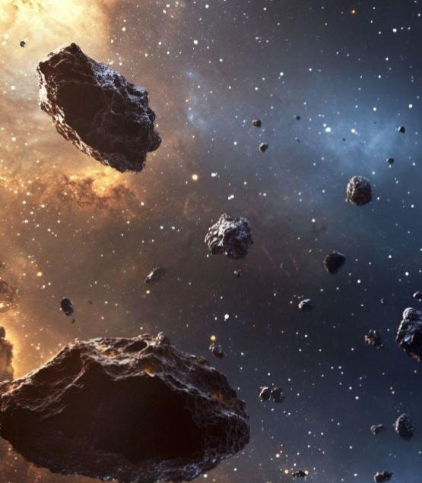
Asteroids: Basics and Impact on Earth
Exploring the rocky remnants of our solar system's formation and their profound influence on planetary evolution and life on Earth

Slide 2
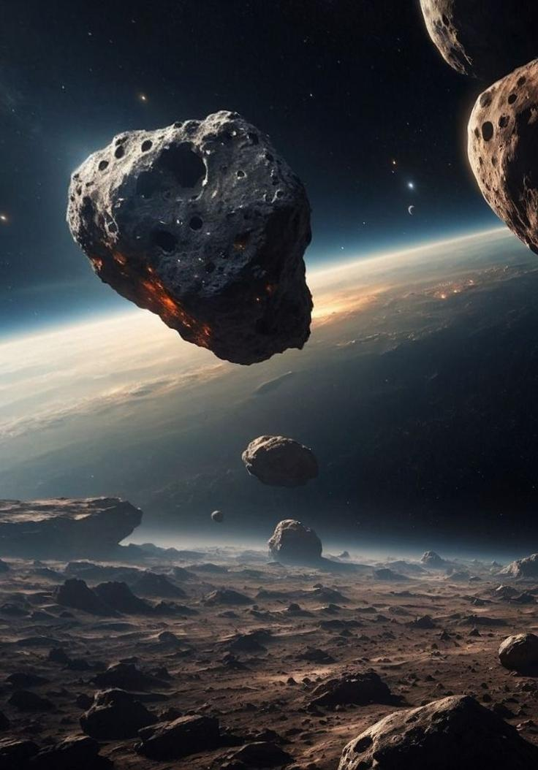
What are Asteroids?
Definition and Key Characteristics
Asteroids are small, rocky bodies orbiting the Sun, ranging from a few metres to hundreds of kilometres in diameter. Often called "minor planets," these celestial objects are remnants from the solar system's formation 4.6 billion years ago.
Irregular shapes due to weak gravitational fields
Composed primarily of rock, metal, and ice
No atmosphere or significant magnetic field
Orbits primarily between Mars and Jupiter

Slide 3
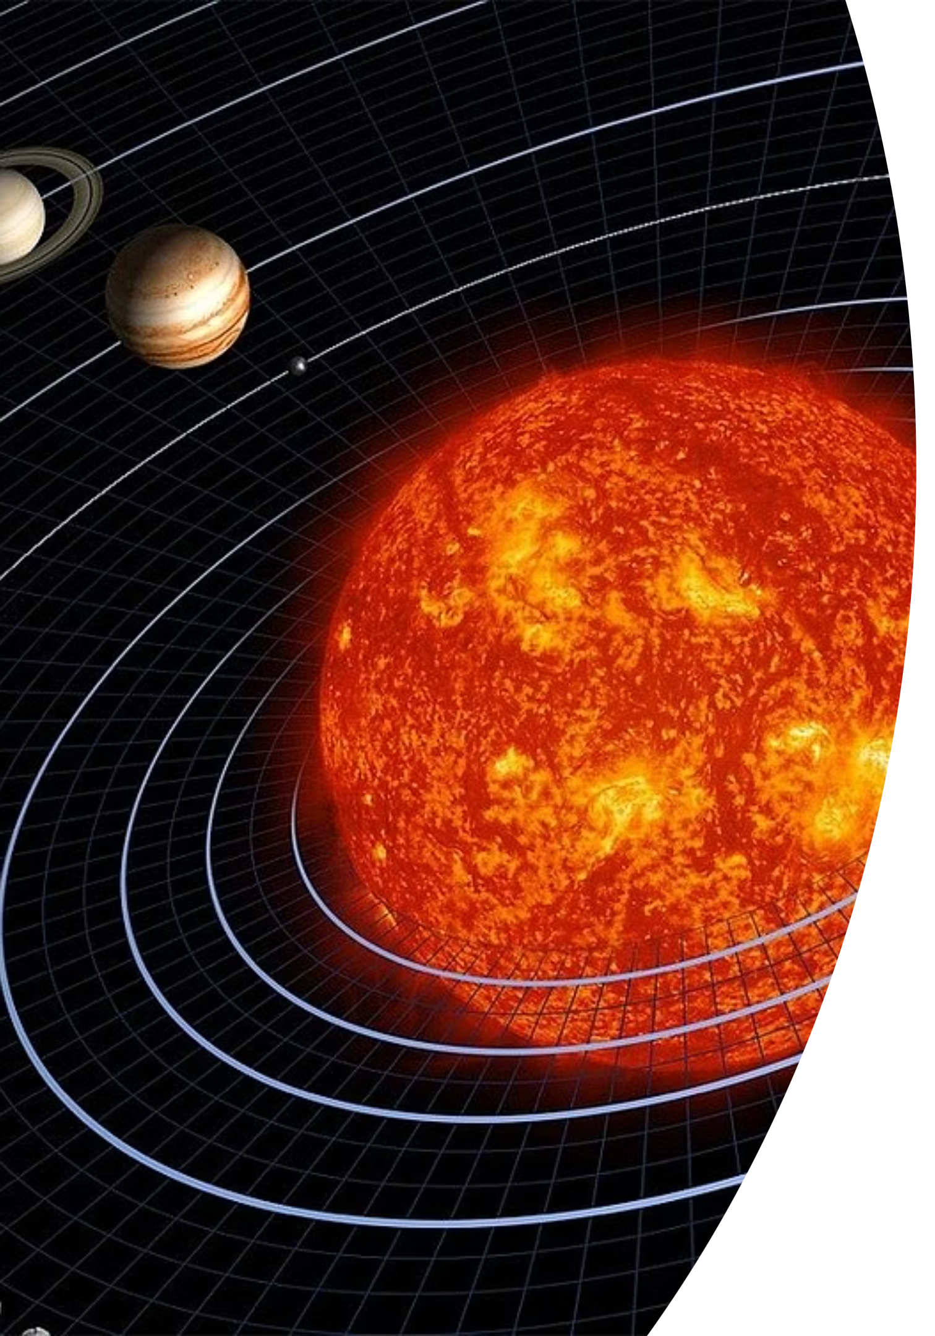
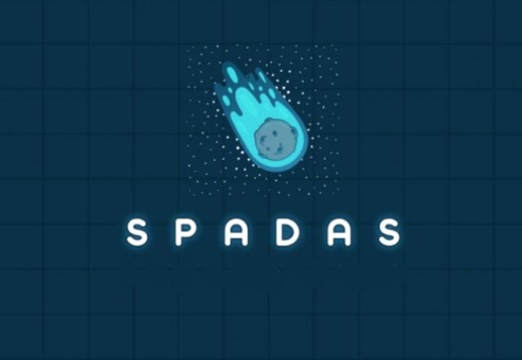
Formation and Composition
01
02
Solar Nebula Collapse
Accretion Process
Gravitational collapse of a giant molecular cloud created the early solar system, leaving behind debris that would form asteroids.
Dust particles collided and stuck together through electrostatic forces, gradually building larger rocky bodies in the primordial disc.
03
Planetary Disruption
Jupiter's massive gravitational influence prevented these rocky fragments from coalescing into a planet, creating the asteroid population we observe today.

Slide 4
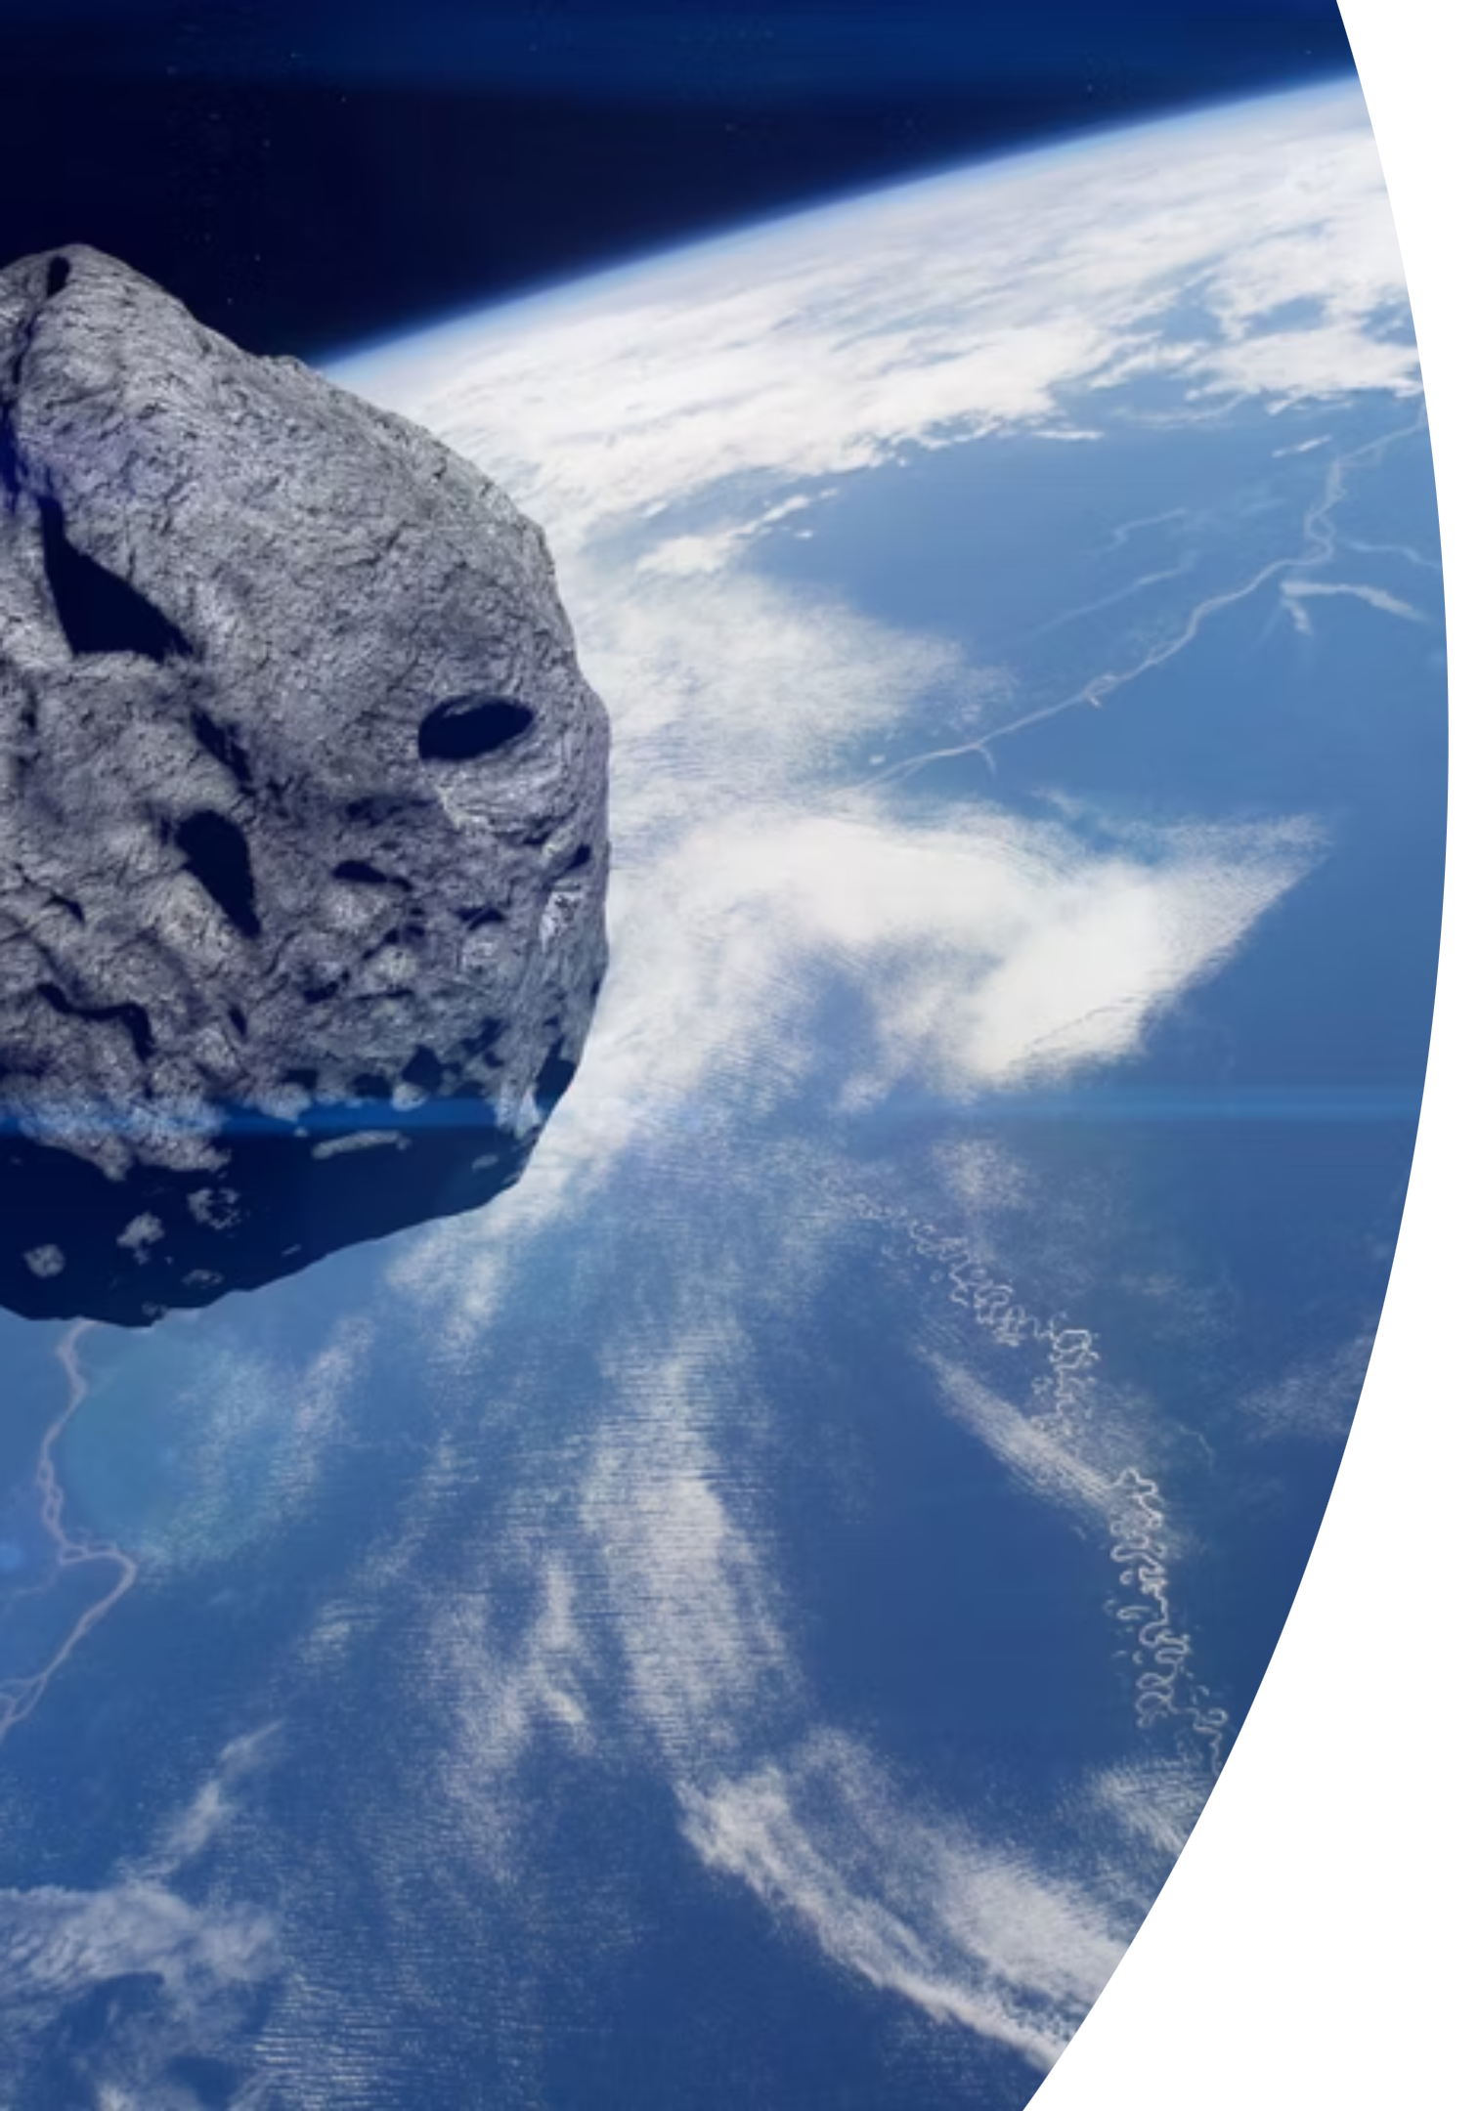
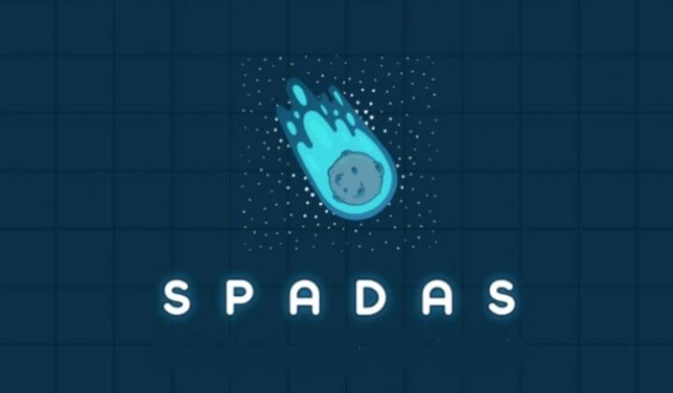
The Asteroid Belt
Location
Population
Situated between Mars and Jupiter, approximately 2.2 to 3.2 astronomical units from the Sun
Contains over 1 million asteroids larger than 1 km and millions of smaller objects
Major Families
Grouped into families like Flora, Vesta, and Eos based on similar orbital characteristics and composition
Despite popular misconceptions, the asteroid belt is mostly empty space, with asteroids separated by millions of kilometres on average.

Slide 5



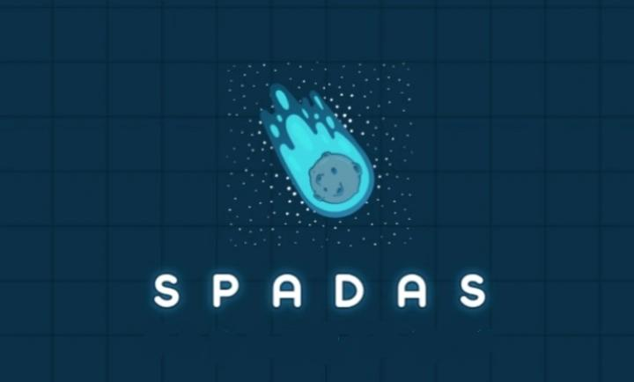
Asteroid Classification Types
C-Type (Carbonaceous)
S-Type (Silicaceous)
M-Type (Metallic)
Rich in nickel-iron metal, these rare asteroids represent only about 8% of the population. They're believed to be the cores of larger bodies that were disrupted by collisions.
The most common asteroids, comprising about 75% of known asteroids. Dark in appearance due to carbon compounds, they contain water-bearing minerals and organic materials. Prime targets for future mining missions.
Composed primarily of silicate minerals and nickel-iron, these moderately bright asteroids make up about 17% of the population. They're found in the inner asteroid belt and are relatively easier to study.

Slide 6
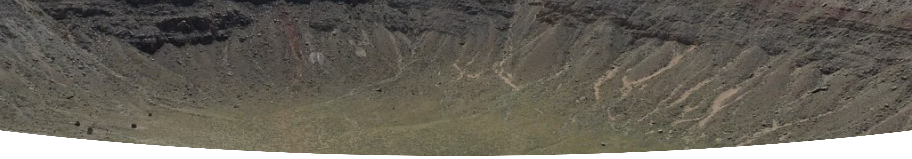
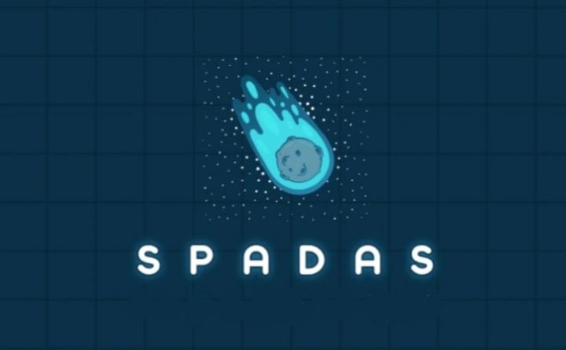
Historical Impact Events
Chicxulub Impact - 66 Million Years Ago
1
A 10-15 km asteroid struck the Yucatan Peninsula, creating a 150 km crater and triggering the mass extinction that ended the age of dinosaurs. The impact released energy equivalent to billions of nuclear bombs.
2
Vredefort Impact - 2 Billion Years Ago
The largest verified impact structure on Earth, this South African crater spans 300 km in diameter, created by an asteroid estimated at 10-15 km across.
Tunguska Event - 1908
3
A relatively small asteroid or comet exploded over Siberia, flattening 2,000 square kilometres of forest. Despite its modest size, it demonstrated the destructive potential of even smaller impacts.

Slide 7
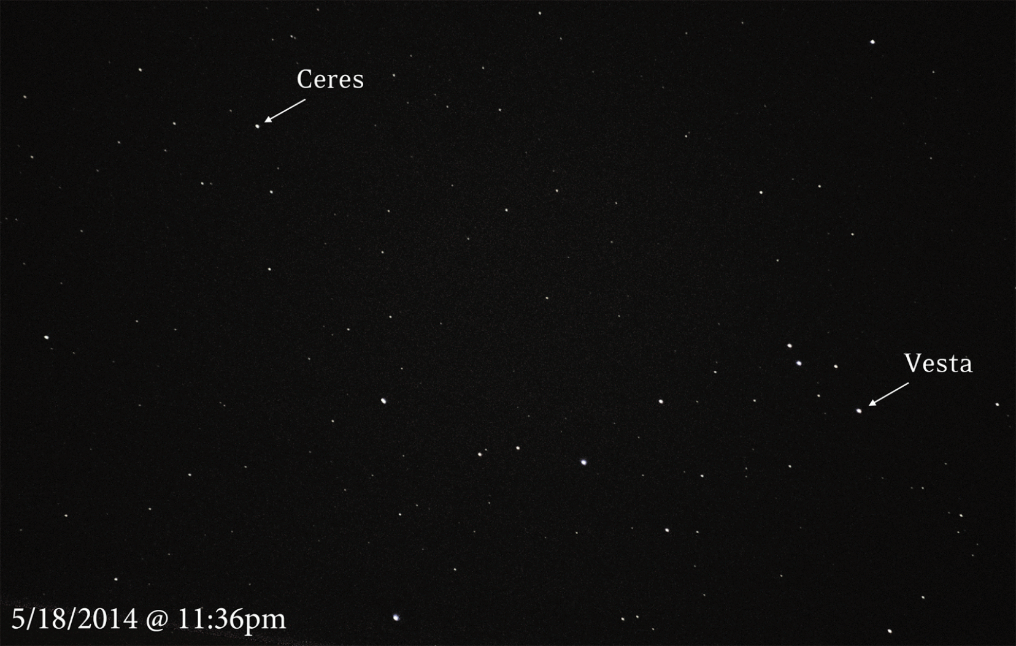

Near-Earth Objects Monitoring
Current Threat Assessment
Scientists have identified over 28,000 Near-Earth Objects (NEOs), with approximately 2,200 classified as Potentially Hazardous Asteroids (PHAs). These objects approach within 7.5 million kilometres of Earth's orbit.
28K+
2.2K
Known NEOs
Hazardous Objects
90%
Detection Rate (>1km)

Slide 8
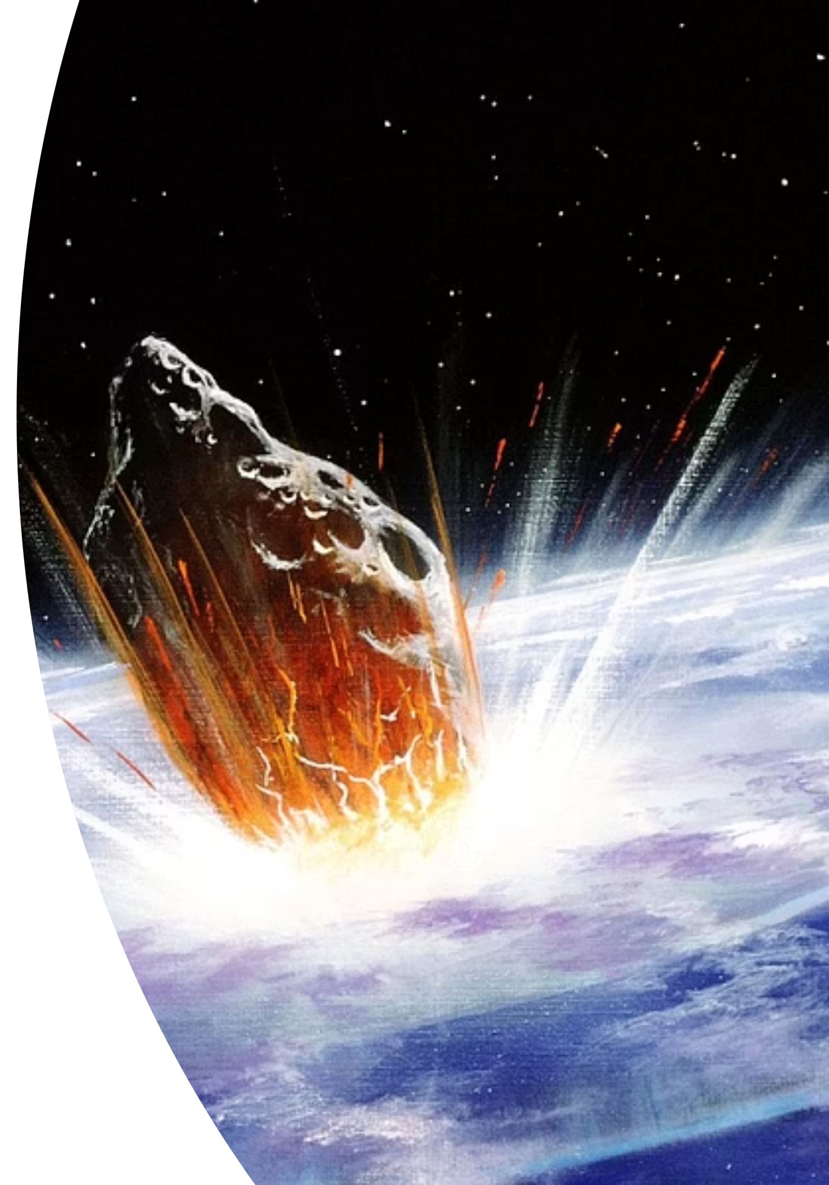



Impact Consequences
Initial Impact
Massive energy release creates shockwaves, tsunamis, and ejecta that can affect global climate systems within hours.
Environmental Change
Dust and debris block sunlight, causing "impact winter" conditions that can last months or years, disrupting photosynthesis.
Mass Extinction
Large impacts trigger ecosystem collapse, leading to widespread species extinction as seen in five major extinction events in Earth's history.

Slide 9



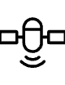
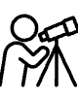

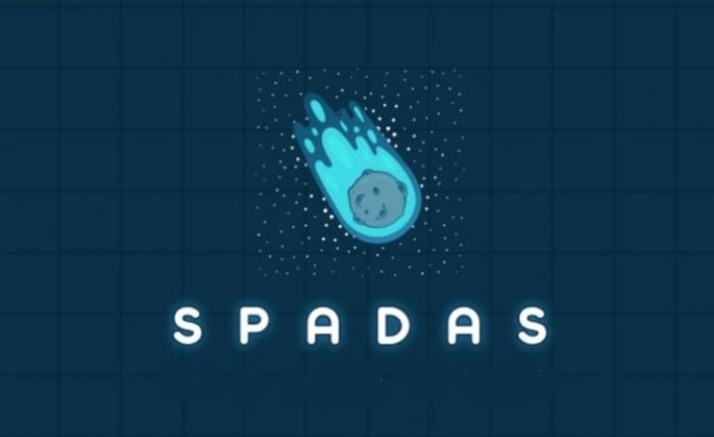
Global Detection Systems
Catalina Sky Survey
NEOWISE Mission
Planetary Radar
Leading ground-based detection programme operating from Arizona, discovering approximately 47% of all known NEOs through automated telescopic surveys.
Space-based infrared telescope that has discovered over 3,000 NEOs by detecting their heat signatures, providing crucial size and composition data.
Arecibo and Goldstone facilities use radar to precisely determine asteroid orbits, rotation rates, and surface features for objects passing within 50 million kilometres.
International collaboration through programmes like the International Asteroid Warning Network ensures rapid information sharing about potential threats.

Slide 10











Planetary Defence Strategies
Orbit Determination
Early Detection
Precise calculations of asteroid trajectories and impact probabilities
Comprehensive sky surveys to identify threats decades before potential impact
Mission Deployment
Launch deflection spacecraft years before projected impact date
Post-Impact Assessment
Monitor deflection success and refined trajectory calculations
Kinetic Impact
Change asteroid velocity through controlled spacecraft collision
NASA's successful DART mission in 2022 proved kinetic impactor technology works, changing asteroid Dimorphos's orbital period by 32 minutes—demonstrating humanity's capability to defend against cosmic threats.

